Slide 1
Outline
Impedance and Admittance Networks
The Transmission (ABCD) Matrix
The Scattering [S] matrix
Reciprocal Networks
Lossless Networks
Shift in Reference Plane
1-Port Networks
2-Port Networks
3-Port Networks
4-Port Networks

Slide 2
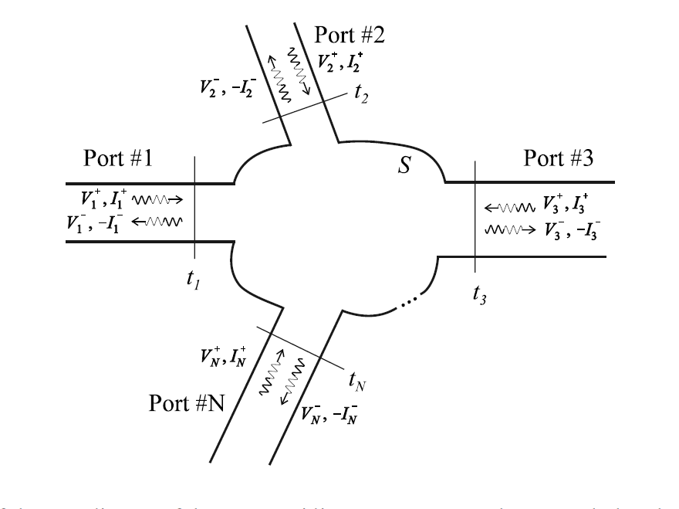
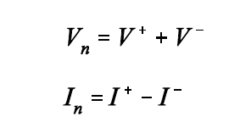
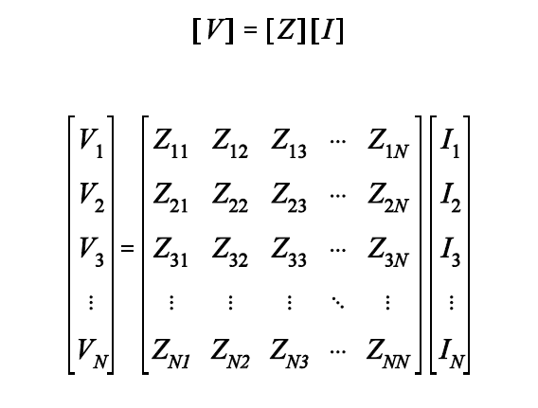
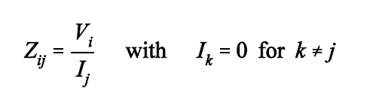
Impedance Network
For reciprocal networks, Z_{nm} = Z_{mn}
For lossless networks: Re{Z_{mn}} = 0

Slide 3
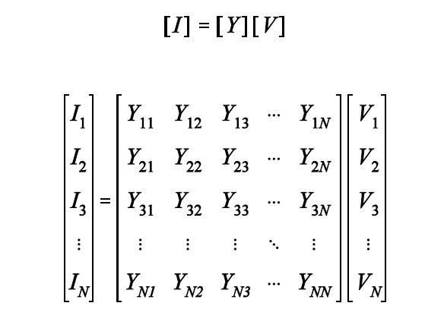
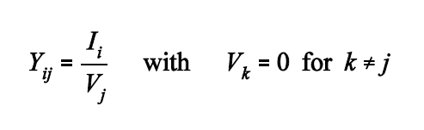
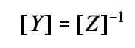
Admittance Network
For reciprocal networks, Y_{nm} = Y_{mn}
For lossless networks: Re{Y_{mn}} = 0

Slide 4
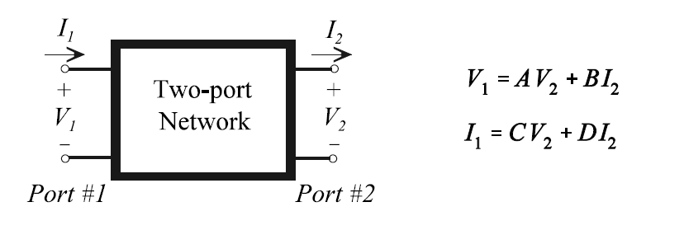
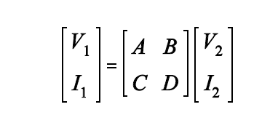
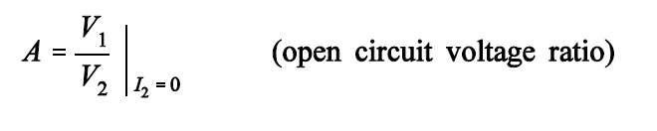
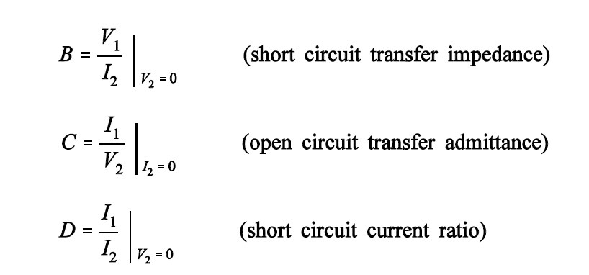
ABCD Matrix

Slide 5
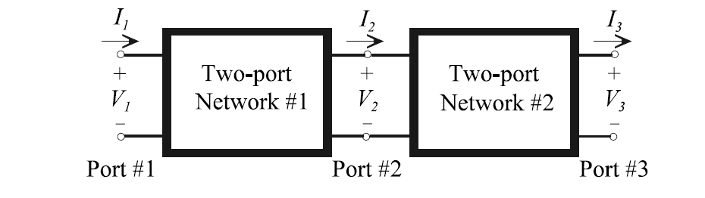
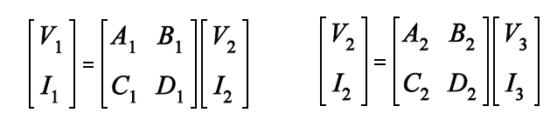
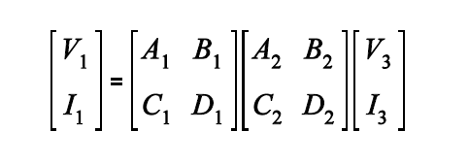
ABCD Matrix

Slide 6
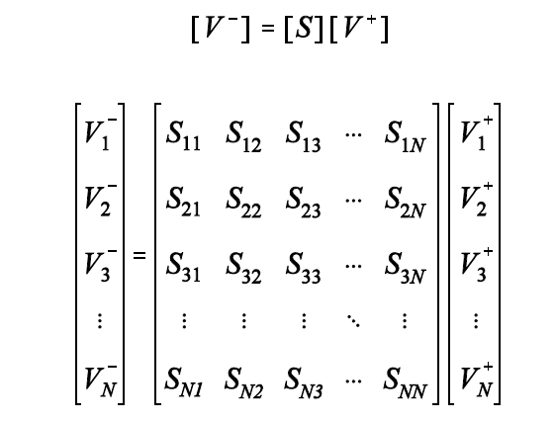
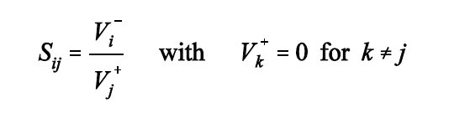
The Scattering Matrix

Slide 7
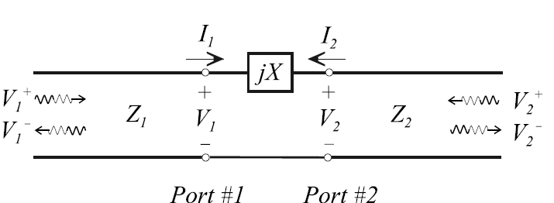
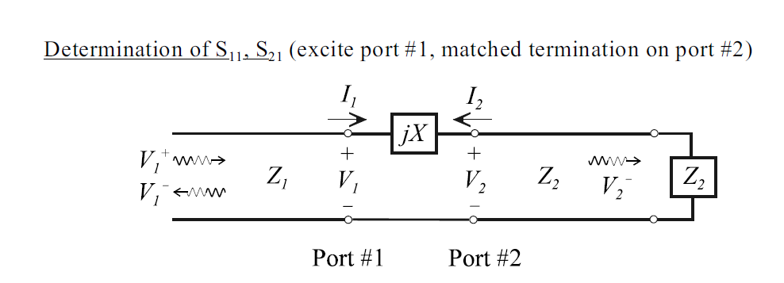
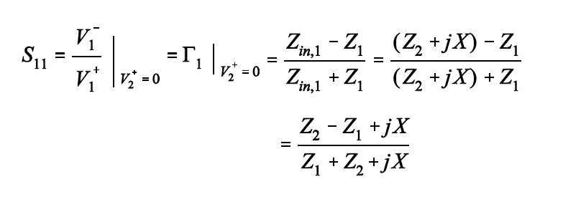
The Scattering Matrix

Slide 8
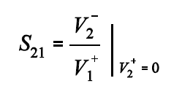
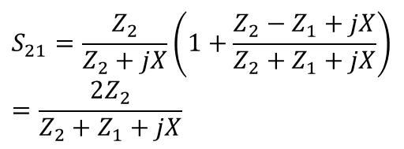
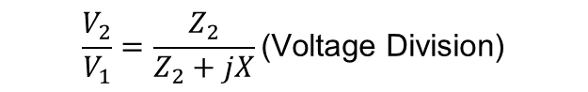
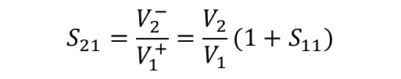
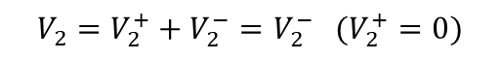
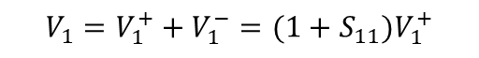
The Scattering Matrix
$$V_{1}=V_{1}^{+}+V_{1}^{−}=(1+S_{11})V_{1}^{+}$$
$$V_{2}=V_{2}^{+}+V_{2}^{−}=V_{2}^{−} (V_{2}^{+}=0)$$
$$S_{21}=\frac{V_{2}^{−}}{V_{1}^{+}}=\frac{V_{2}}{V_{1}}(1+S_{11})$$
$$\frac{V_{2}}{V_{1}}=\frac{Z_{2}}{Z_{2}+jX}\text{(}\text{Voltage} \text{Division}\text{)}$$
$$S_{21}=\frac{Z_{2}}{Z_{2}+jX}\left(1+\frac{Z_{2}−Z_{1}+jX}{Z_{2}+Z_{1}+jX}\right)=\frac{2Z_{2}}{Z_{2}+Z_{1}+jX}$$

Slide 9
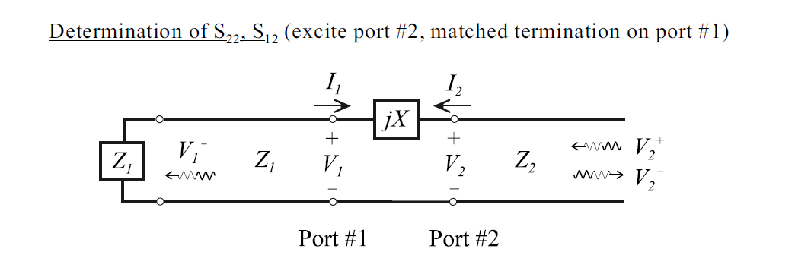
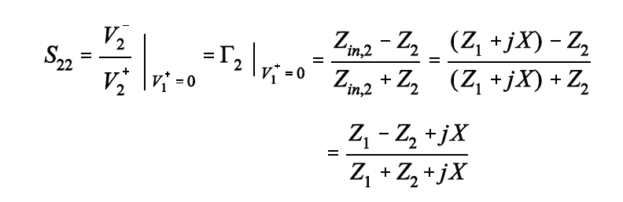
The Scattering Matrix

Slide 10
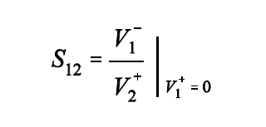
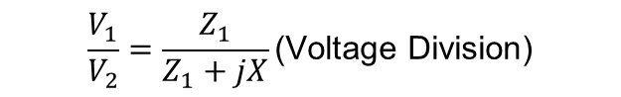
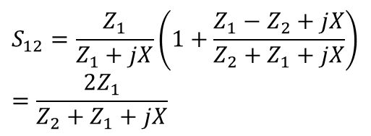
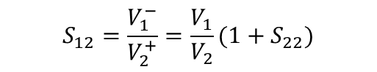
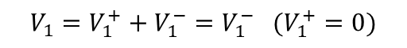
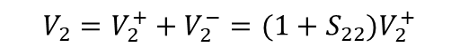
The Scattering Matrix
$$V_{2}=V_{2}^{+}+V_{2}^{−}=(1+S_{22})V_{2}^{+}$$
$$V_{1}=V_{1}^{+}+V_{1}^{−}=V_{1}^{−} (V_{1}^{+}=0)$$
$$S_{12}=\frac{V_{1}^{−}}{V_{2}^{+}}=\frac{V_{1}}{V_{2}}(1+S_{22})$$
$$\frac{V_{1}}{V_{2}}=\frac{Z_{1}}{Z_{1}+jX}\text{(}\text{Voltage} \text{Division}\text{)}$$
$$S_{12}=\frac{Z_{1}}{Z_{1}+jX}\left(1+\frac{Z_{1}−Z_{2}+jX}{Z_{2}+Z_{1}+jX}\right)=\frac{2Z_{1}}{Z_{2}+Z_{1}+jX}$$

Slide 11
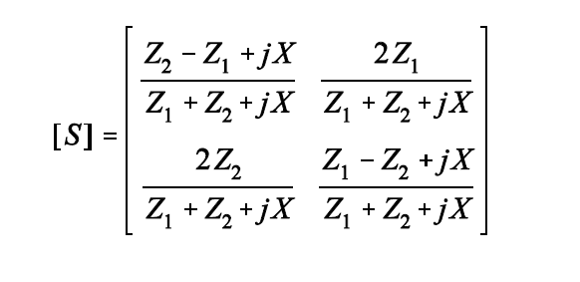
The Scattering Matrix
?

Slide 12
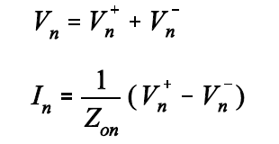
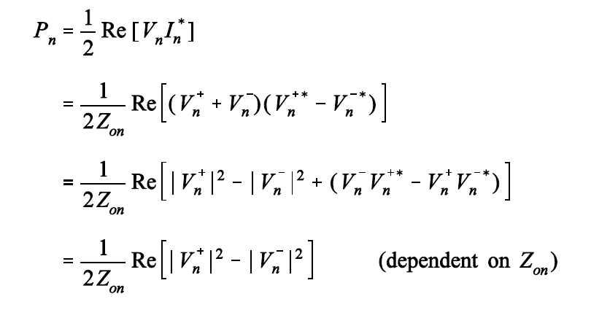
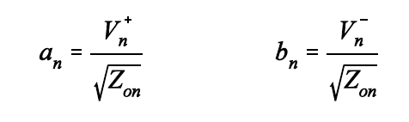
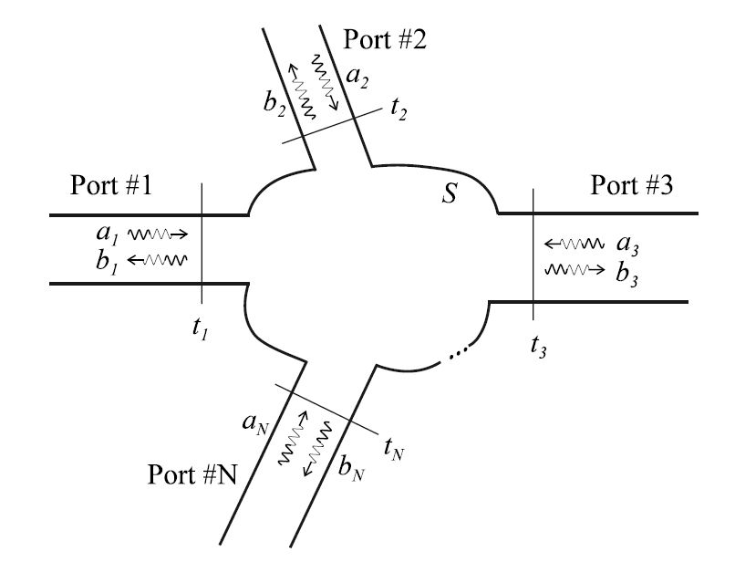
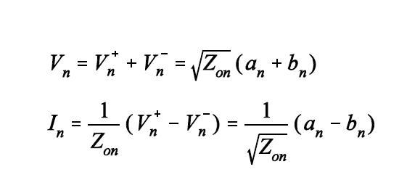
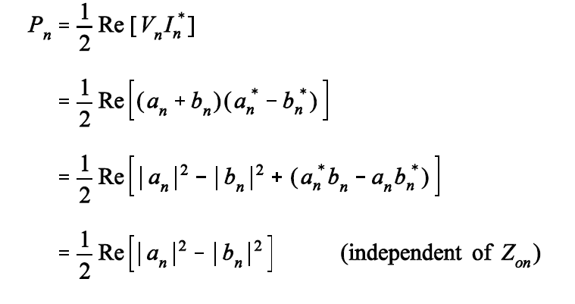
Generalized Scattering Matrix
Define

Slide 13
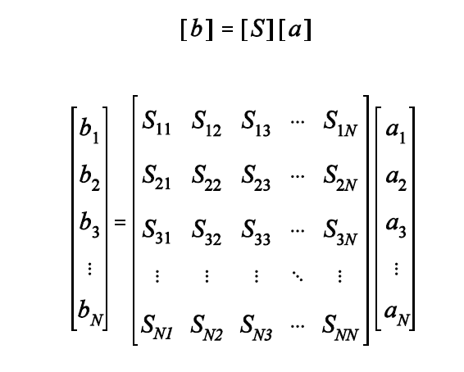
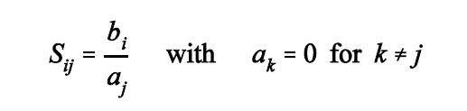
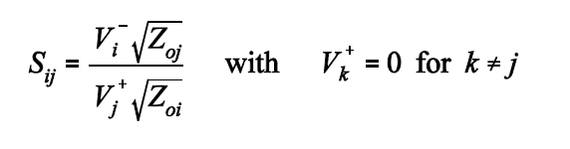
Generalized Scattering Matrix

Slide 14
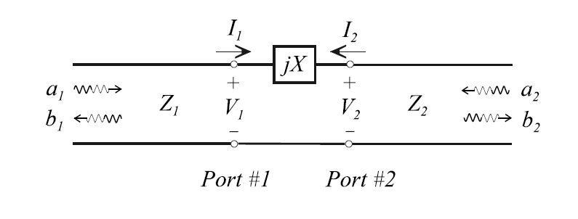
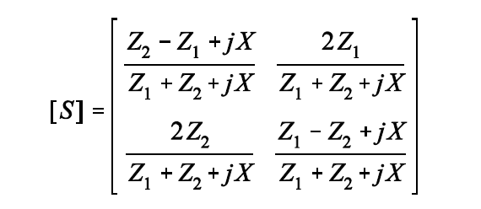
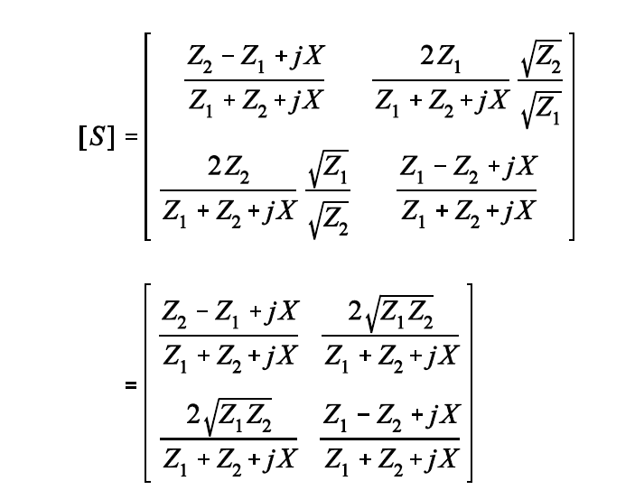
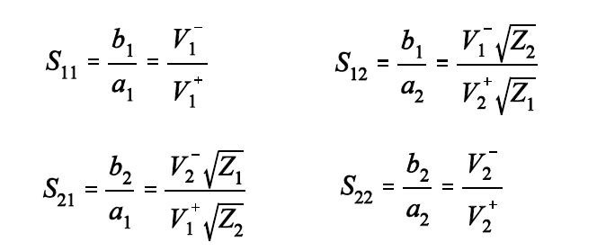
Generalized Scattering Matrix

Slide 15
Reciprocal Networks
If the system is linear and made entirely of reciprocal material (resistors, capacitors, inductors), the network is reciprocal.

Slide 16
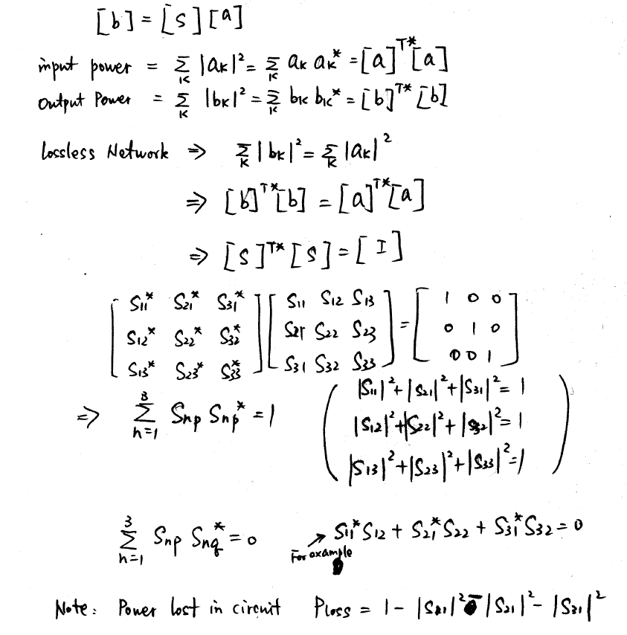
Lossless Networks

Slide 17
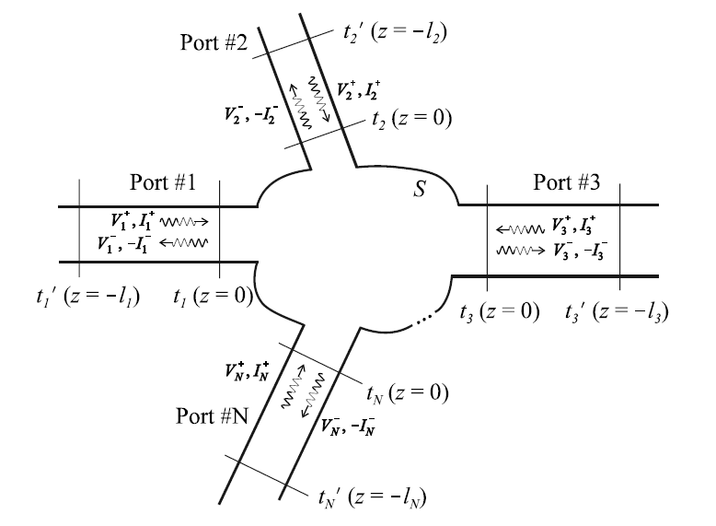
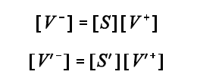



Shift in Reference Plane

Slide 18




Shift in Reference Plane

Slide 19
1-Port Networks

Slide 20
2-Port Networks

Slide 21



2-Port Networks - Isolator

Slide 22






2-Port Networks - Attenuator
100W

Slide 23



2-Port Networks – Phase Shifter

Slide 24
3-Port Networks

Slide 25
3-Port Networks

Slide 26


3-Port Networks - Circulator

Slide 27



3-Port Networks - T Junction

Slide 28

3- Port Networks – T Junction

Slide 29
3-Port Networks - T Junction with Loss

Slide 30





3-Port Networks – Wilkinson Power Divider

Slide 31


3-Port Networks – Wilkinson Power Divider
$$\left[S\right]= \frac{1}{\sqrt{2}} \left[\begin{matrix}0 & −j & −j \\ −j & 0 & 0 \\ −j & 0 & 0\end{matrix}\right]$$

Slide 32
3-Port Networks – Wilkinson Power Divider

Slide 33
3-Port Networks – Wilkinson Power Divider

Slide 34
3-Port Networks – Wilkinson Power Divider

Slide 35
3-Port Networks – Wilkinson Power Divider
Half circuit:

Slide 36


3-Port Networks – Wilkinson Power Divider
$$V_{2}^{o}=\frac{V_{s}}{2}\frac{Z_{0}}{Z_{0}+Z_{0}}=\frac{V_{s}}{4}$$
$$V_{3}^{o}=−\frac{V_{s}}{2}\frac{Z_{0}}{Z_{0}+Z_{0}}=−\frac{V_{s}}{4}$$

Slide 37
3-Port Networks – Wilkinson Power Divider

Slide 38
3-Port Networks – Wilkinson Power Divider
Half circuit:

Slide 39


3-Port Networks – Wilkinson Power Divider
$$V_{2}^{e}=\frac{V_{s}}{2}\frac{Z_{0}}{Z_{0}+Z_{0}}=\frac{V_{s}}{4}$$
$$V_{3}^{e}=\frac{V_{s}}{2}\frac{Z_{0}}{Z_{0}+Z_{0}}=\frac{V_{s}}{4}$$

Slide 40

3-Port Networks – Wilkinson Power Divider
Finding this answer is not as easy as you might think. But it is rewarding!
$$V_{1}^{e}=\frac{−jV_{s}}{2\sqrt{2}}$$

Slide 41



3-Port Networks – Wilkinson Power Divider
$${V_{1}=V}_{1}^{e}+V_{1}^{o}=0−\frac{jV_{s}}{2\sqrt{2}}=−\frac{jV_{s}}{2\sqrt{2}}$$
$${V_{2}=V}_{2}^{e}+V_{2}^{o}=\frac{V_{s}}{4}+\frac{V_{s}}{4}=\frac{V_{s}}{2}$$
$${V_{3}=V}_{3}^{e}+V_{3}^{o}=\frac{V_{s}}{4}−\frac{V_{s}}{4}=0$$

Slide 42







3-Port Networks – Wilkinson Power Divider
$$V_{2}^{+}=\frac{V_{s}}{2}$$
$$V_{2}^{−}=0$$
Z_{in} at Port 2 is equal to Z_{o}
$$V_{1}^{−}=−\frac{jV_{s}}{2\sqrt{2}}$$
$$V_{1}^{+}=0$$
Port 1 is matched
$$V_{3}^{+}=0$$
$$V_{3}^{−}=0$$
Port 3 is matched
$$\left[S\right]= \frac{1}{\sqrt{2}} \left[\begin{matrix}0 & −j & −j \\ −j & 0 & 0 \\ −j & 0 & 0\end{matrix}\right]$$

Slide 43
4-Port Networks

Slide 44
4-Port Networks
Such a device is called ideal directional coupler

Slide 45

4-Port Networks - Cross Junction

Slide 46





4-Port Networks – Branch Line Coupler
$$=\frac{1}{\sqrt{2}}\left[\begin{matrix}±1 & j \\ j & ±1\end{matrix}\right]$$
- for even mode
+ for odd mode

Slide 47




4-Port Networks – Branch Line Coupler
Even mode:
$$S_{11}^{e}=\frac{A+B−C−D}{A+B+C+D}=0$$
$$S_{21}^{e}=\frac{2}{A+B+C+D}=−\frac{1}{\sqrt{2}}(1+j)$$
Odd mode:
$$S_{11}^{o}=\frac{A+B−C−D}{A+B+C+D}=0$$
$$S_{21}^{o}=\frac{2}{A+B+C+D}=\frac{1}{\sqrt{2}}(1−j)$$

Slide 48






4-Port Networks – Branch Line Coupler
$$V_{1}^{e}=V_{1}^{o}=\frac{1}{2}$$
$$V_{4}^{e}={−V}_{4}^{0}=\frac{1}{2}$$
Port 1 is excited
$V_{1}^{−}=V_{1}^{e}S_{11}^{e}+V_{1}^{o}S_{11}^{o}$=0
No reflection at Port 1
$V_{2}^{−}=V_{1}^{e}S_{21}^{e}+V_{1}^{o}S_{21}^{o}=\frac{−j}{\sqrt{2}}$
Half power, 90º phase delay
$V_{3}^{−}=V_{4}^{e}S_{21}^{e}+V_{4}^{o}S_{21}^{o}=\frac{−1}{\sqrt{2}}$
Half power, 180º phase delay
$V_{4}^{−}=V_{4}^{e}S_{11}^{e}+V_{4}^{o}S_{11}^{o}=0$
Port 4 is isolated

Slide 49

4-Port Networks – Branch Line Coupler

Slide 50

4-Port Networks – Branch Line Coupler

Slide 51






4-Port Networks – Rat Race Coupler

